Slide 1

ISSIP Onboarding Course
Professor-Led Course

Slide 2
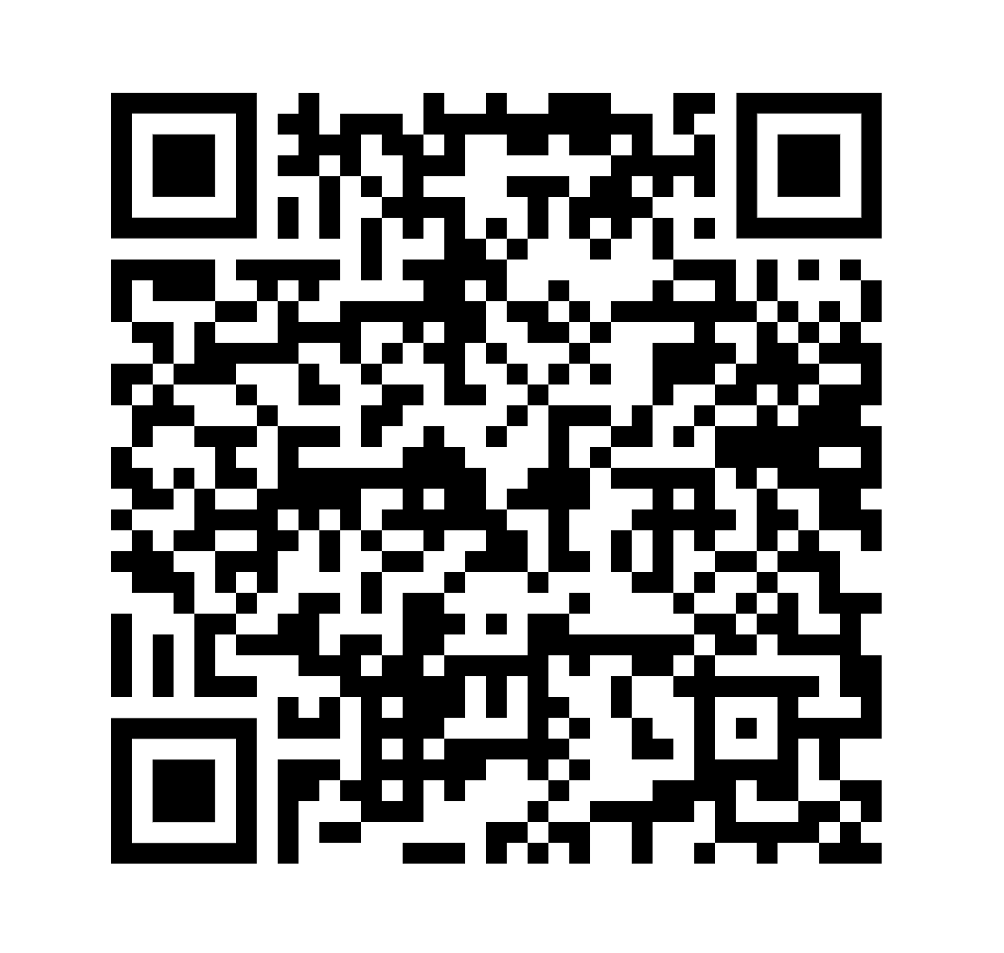
Before We Begin
Before starting the course, click the link or scan the QR code on your mobile device, and complete the Pre-test: Click here
Notes:
Welcome, everyone! Before we dive into today’s onboarding session, please take a moment to complete the pre-test using the link or QR code provided. This will help us understand your starting point and better tailor the session to our group.

Slide 3

Section A: Service in the AI Era
Learning Objectives:
Define service in a modern context and explain the Give-Get-Grow principle
Evaluate innovations through the four guiding questions of service innovation
Identify the role of AI, digital platforms, and tech in amplifying service
Distinguish between service practice and service research
Understand how education transmits service knowledge across disciplines
Describe Service Science and its role in studying evolving service systems
Compare Goods-Dominant Logic and Service-Dominant Logic (S-D Logic)
Understand the concept of Service-Dominant Architecture (SDA)
Describe T-shaped professionals and their relevance to innovation and lifelong learning
Notes:
This section introduces you to the foundational ideas of service innovation and its intersection with technology, especially AI. We'll cover how service is defined, the concept of Service-Dominant Logic, and the importance of being a T-shaped professional in today's evolving service landscape.

Slide 4
Service is Central
🔹 “Service is the application of resources for the benefit of another.”
→ This includes knowledge, time, skills, technology, or emotional support.
→ It’s not limited to jobs or customer service — it happens every time we help others.
🔹 Becoming better at helping others = personal + professional growth
→ In school: helping classmates builds leadership and collaboration skills
→ At work: service leads to better teamwork, communication, and trust
→ In life: service deepens empathy and expands your network
🔹 All systems engage in service: people, businesses, nations
→ A person helping a friend = service
→ A business improving user experience = service
→ A government launching a public health campaign = service
→ Service systems interact and evolve constantly — that’s what makes it a field of study
💬 Exercise Prompt:
List 3 ways you’ve helped others recently.
Think beyond just formal roles — consider advice, support, sharing resources, or even uplifting someone’s mood.
Notes:
Service is more than customer support—it's any application of resources to help someone else. It could be as simple as sharing advice or as complex as designing AI systems. This slide highlights how being better at helping others leads to personal growth, stronger teams, and societal progress. Let’s reflect: think of three recent ways you’ve helped others—big or small.

Slide 5
Service Innovation Strategy
Innovation isn’t always good — intent matters
→ Even helpful tools can cause harm without the right strategy
4 guiding questions for ethical innovation:
→ Should we? – Is this the right thing to do?
→ Can we? – Do we have the ability to do it well?
→ May we? – Is it allowed, legal, and respectful of others?
→ Will we? – Are we truly committed, and is this the right time?
Goal: Design innovations that benefit people and reduce harm
→ Service professionals must think beyond “can we build it?” to “should we?”
Notes:
Innovation isn’t inherently positive—it needs intent and responsibility. These four guiding questions help evaluate ethical innovation. Ask yourself not only 'Can we build it?' but 'Should we?' This mindset ensures service innovations are thoughtful, sustainable, and beneficial.

Slide 6

The Role of AI and Tech in Service
Service has evolved:
Face-to-face → Digitally mediated → AI-assisted
AI tools amplify service, but also change how it's delivered
→ Chatbots, recommendation engines, virtual agents
Digital service is the new norm
→ People expect 24/7 access, personalization, and speed
→ Technology is now part of the service team
Challenge: Keep tech human-centered, not just efficient
Notes:
Technology is transforming how we deliver service—from AI chatbots to recommendation engines. But with these advances come new responsibilities. We must keep service human-centered, ensuring tech augments empathy and quality, not just efficiency.

Slide 7
Service Practice & Research
Practice = Applying knowledge to create real-world results
→ Used by businesses, governments, and nonprofits to deliver value
Research = Generating new knowledge and improving what exists
→ Explores service delivery, customer experience, tech, and more
→ Guides decisions with data, not just assumptions
Together, research informs better practice — and practice inspires new research
💬 Reflection Prompt: Explore the Journal of Service Research and pick one article that sparks your curiosity: https://journals.sagepub.com/doi/10.1177/10946705241311210
Notes:
Practice and research are two sides of the same coin. Practitioners use tools and data to serve others, while researchers generate new knowledge to improve those tools. Together, they drive better outcomes. You’ll also see a prompt to explore an article from the Journal of Service Research—consider it an invitation to dig deeper.

Slide 8
Service Education & Service Science
Education = Our tool for spreading service knowledge
→ Prepares future leaders across business, engineering, health, and policy
→ Teaches collaboration, ethics, systems thinking, and innovation
Service Science = The study of how service systems evolve and interact
→ Includes people, tech, orgs, and value exchange in dynamic systems
SSME-DAPP: A cross-disciplinary approach
→ Science, Mgmt, Eng., Design, Arts, Public Policy
Notes:
Education spreads service knowledge across disciplines—business, engineering, health, and more. Service Science is the study of how these systems interact and evolve. ISSIP embraces a cross-disciplinary framework—SSME-DAPP—that integrates science, management, design, and policy.

Slide 9
S-D Logic & Architecture
Service-Dominant Logic (S-D Logic)
→ Value is co-created, not just delivered
→ Customers, providers, and partners all contribute to the outcome
S-D Architecture
→ A framework to design organizations for adaptability, value exchange, and continuous innovation
→ Supports collaboration across people, platforms, and ecosystems
💡 Optional Resource:
SDA Certification Course Link for deeper learning: https://www.ifsd.hamburg/CERTIFICATE-SDA-PROFESSIONAL-ONE/
Notes:
Service-Dominant Logic shifts our thinking: value is co-created by all participants—not just delivered. S-D Architecture offers a structure for designing adaptable, collaborative organizations. If you’re interested, there’s a link to a certification for deeper learning.

Slide 10
T-Shaped Professionals
Depth + Breadth = Strong Teams
→ Depth = Specialization in one area
→ Breadth = Ability to collaborate across roles and disciplines
Grow across 6 dimensions:
Tech · Industry · Culture · Discipline · Practice · Mindset
T-shaped people learn fast, connect ideas, and drive innovation
💬 Reflection Prompt: Name one skill you’re strong in and one you want to grow
Notes:
T-shaped professionals combine depth in one area with broad collaboration skills across disciplines. This model is central to innovation and lifelong learning. Take a moment to reflect on one skill you're strong in, and one you’d like to grow.

Slide 11

SECTION B: ISSIP as an Organization
Learning Objectives:
Summarize ISSIP’s mission, nonprofit status, and value-driven culture
Locate and explain the Code of Conduct, Annual Calendar, and Bylaws
Identify ISSIP’s Programs and Communities of Practice and how they function
Understand the Constellation of Platforms used for global engagement
Register at ISSIP.org, sign up for the newsletter, and navigate key engagement points
Explore how ISSIP promotes conferences, publications, and volunteer-led content
Link to ISSIP company handbook for context and elaboration of each of these objectives: https://issip.org/wp-content/uploads/2024/08/ISSIP-Handbook-2024-Edition.pdf
Notes:
Now let’s focus on ISSIP itself—its mission, values, structure, and how you can participate. ISSIP is a nonprofit built on community, collaboration, and responsible service innovation.

Slide 12
What is ISSIP?
ISSIP = International Society of Service Innovation Professionals
→ A global community of professionals, researchers, and students
Mission: Advance service innovation for a smarter, more sustainable world
→ Focus on improving lives through responsible innovation
Nonprofit & volunteer-led
→ Programs are shaped by members — not corporations
Notes:
ISSIP stands for the International Society of Service Innovation Professionals. It’s a global nonprofit community focused on advancing service innovation responsibly. Members include students, professionals, and researchers, all contributing to a smarter, more sustainable world.

Slide 13
Key Elements of ISSIP
Code of Conduct
→ Built on respect, contribution, and integrity
→ Encourages open collaboration and inclusive participation
Annual Calendar
→ ISSIP runs events, newsletters, awards, and meetings
→ Opportunities to connect, share work, and stay informed
Bylaws & Nonprofit Mission
→ ISSIP is transparent, inclusive, and member-driven
→ Everyone has a voice — students can lead and grow here
💬 Reflection Prompt:
Why do you think having a Code of Conduct is important in an open, global innovation community?
Notes:
Three key pillars guide ISSIP: a respectful Code of Conduct, a transparent Annual Calendar, and its nonprofit Bylaws. These ensure inclusivity, open collaboration, and opportunities for everyone—especially students—to lead and grow.

Slide 14
ISSIP Programs and Platforms
Communities of Practice (CoPs)
→ Volunteer-led teams around topics like AI, service design, education, and more
→ Great entry point for students to get involved and lead projects
Shared Goals of Every Program:
→ Share knowledge across fields
→ Gain recognition for contributions
→ Grow your network with global professionals
Notes:
ISSIP’s Communities of Practice (CoPs) bring people together around shared interests—like AI or service design. Programs help members share knowledge, gain recognition, and build global networks. Everyone is encouraged to get involved.

Slide 15

SECTION C: Participation Opportunities
Learning Objectives:
Explain the Give-Get-Grow participation model and how it drives ISSIP’s culture
Identify opportunities to engage through newsletters, elections, and awards
Follow and engage with ISSIP on LinkedIn, YouTube, and Slideshare
Find and connect with ISSIP Ambassadors to grow their professional network
Learn how to track contributions through Benevity or support ISSIP financially
Notes:
ISSIP thrives through the Give-Get-Grow model. By contributing your time and ideas, you gain recognition and grow your skills and network. This section covers how you can engage with ISSIP and make the most of your experience.

Slide 16
Culture of Give-Get-Grow
Give: Time, knowledge, encouragement
→ Share your skills and ideas — even as a student
→ Helping others builds confidence and trust
Get: Recognition, mentorship, collaboration
→ Your contributions are valued and visible
→ ISSIP members often spotlight student work
Grow: Network, skillset, career impact
→ Build real-world experience through volunteer projects
→ Gain access to global professionals and leaders
✅ Keep ISSIP informal, personal, and people-first — this is a community, not a corporation
💬 Reflection Prompt:
What’s one way you could “Give” in a student or professional setting right now?
Notes:
This is the heart of ISSIP. You 'give' your knowledge, time, and ideas. You 'get' support, mentorship, and visibility. You 'grow' through hands-on experience and expanded professional networks. Let’s reflect—what’s one way you could give in your current setting?

Slide 17
Ways to Get Involved
Subscribe to ISSIP’s Monthly Newsletter: https://issip.org/newsletters/
→ Stay updated on events, awards, and thought leadership
Participate in VP Elections (Nominate + Vote)
→ Help shape the direction of ISSIP’s future
→ Students can nominate and be nominated!
Earn Recognition Through ISSIP Awards
→ Celebrate innovation, leadership, and contributions to service
Contribute Your Voice
→ Write a blog post, join a panel, or present your work
→ No experience needed — just curiosity and willingness to share
Notes:
There are many ways to engage—subscribe to the newsletter, participate in elections, apply for awards, or contribute content. Even as a student or newcomer, your voice and contributions matter. Don’t wait to be invited—jump in.

Slide 18
Follow ISSIP Everywhere
✅Register at issip.org
https://issip.org/membership/
✅ LinkedIn
https://www.linkedin.com/company/international-society-of-service-innovation-professionals-issip-/
✅ Subscribe on YouTube
https://www.youtube.com/@ISSIPorg
✅ Follow on Slideshare
https://www.slideshare.net/issip
✅ Volunteer through Benevity
https://issip.org/2024/09/10/increase-your-impact-issip-is-now-an-approved-benevity-cause/
Notes:
To stay connected, follow ISSIP on all platforms: LinkedIn, YouTube, Slideshare, and Benevity for volunteering. Make sure you’re registered and subscribed—this keeps you in the loop and gives access to all engagement opportunities.

Slide 19
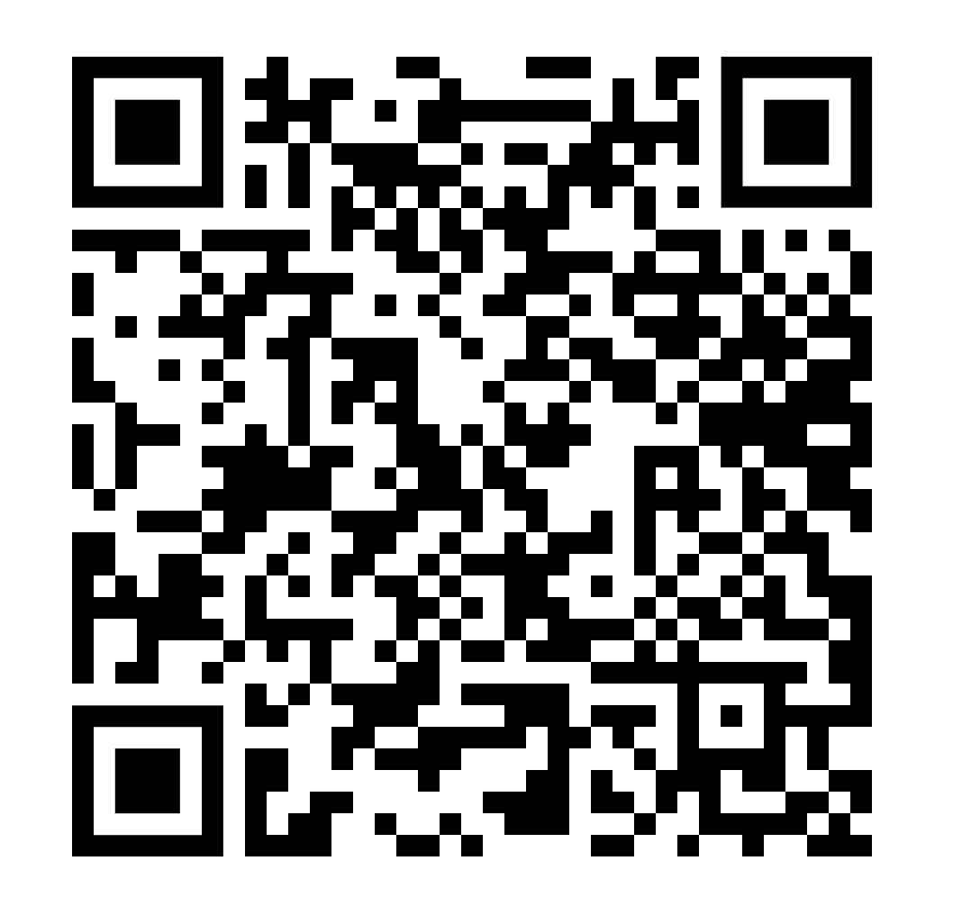

After the Course
Click the link or scan the QR code on your mobile device to complete the Post-Test after completing the course: Click here
Reflect on what resonated most with you
Notes:
Thanks for participating! Please complete the post-test using the QR code or link. We also encourage you to reflect—what resonated most with you today? What will you take forward into your professional life?

